Slide 1


Universities and Colleges: Enrollment, Tuition, Earnings, and Graduation Rate
David Williams

Slide 2
Contents
Montgomery College Enrollment
Tuition Assistant
Earning after Graduation
Graduation Rate

Slide 3

Montgomery College Enrollment
This section will analyze the enrollment demographic of the three campus of Montgomery College

Slide 4
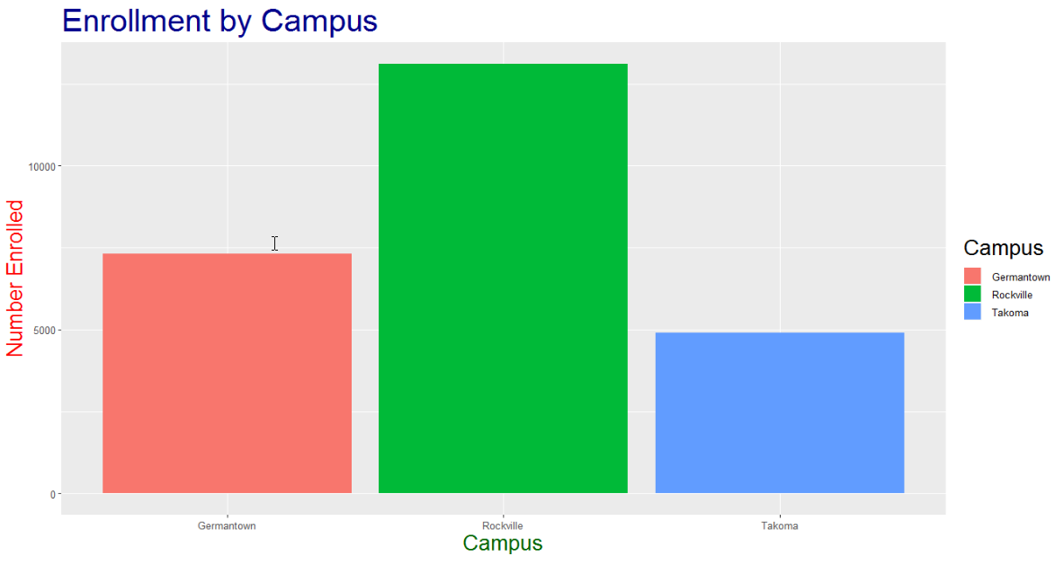

Slide 5
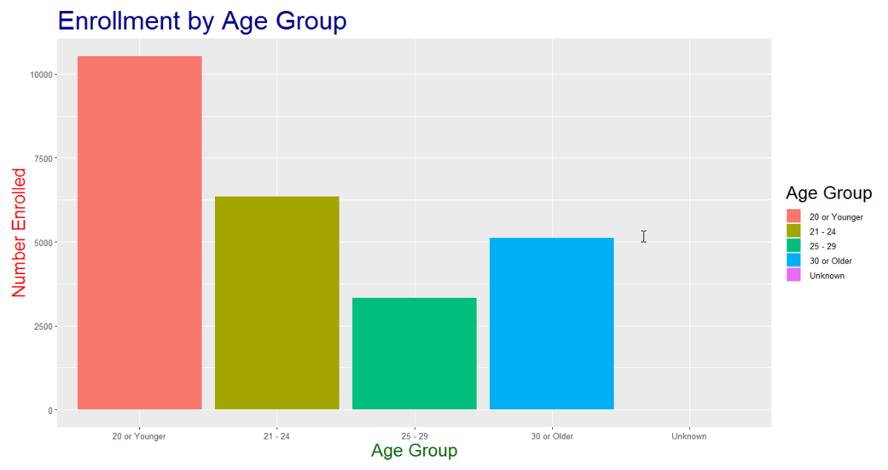

Slide 6
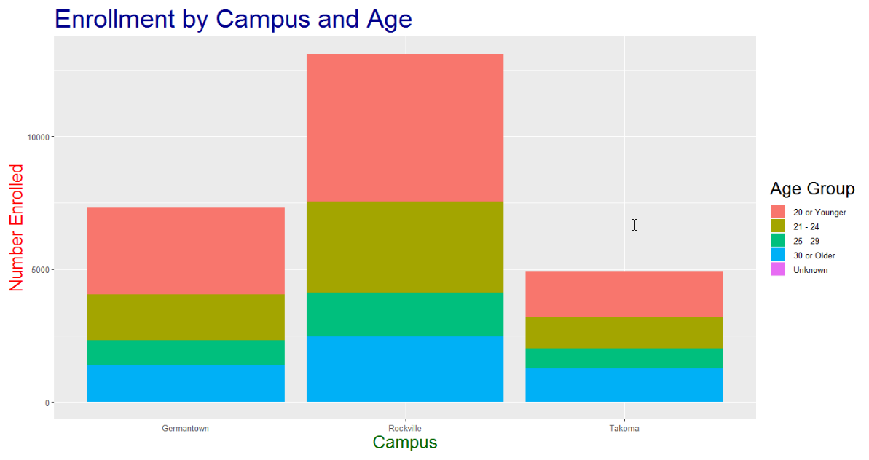

Slide 7
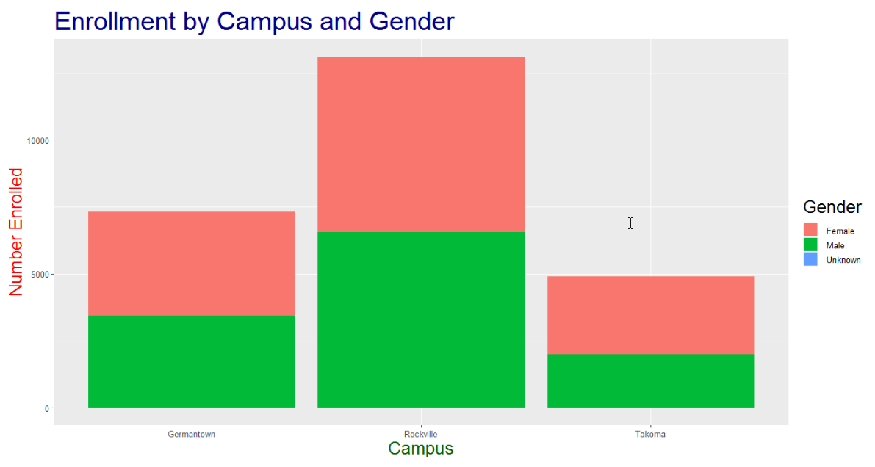

Slide 8
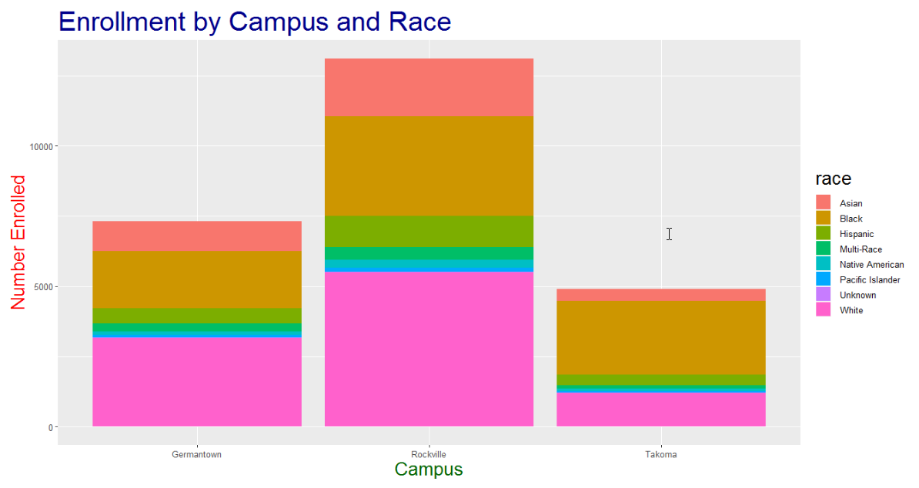

Slide 9
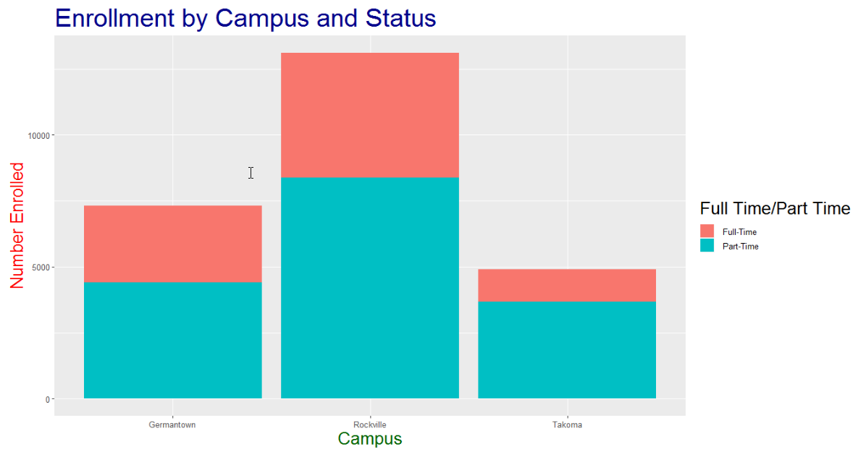

Slide 10
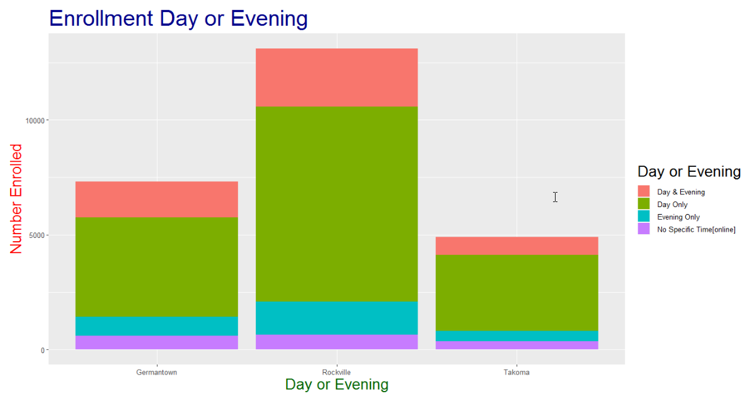

Slide 11
Enrollment by Campus and Program
https://public.tableau.com/profile/david.williams8099#!/vizhome/CampusbyProgram/EnrollmentbyCampusandProgram?publish=yes

Slide 12
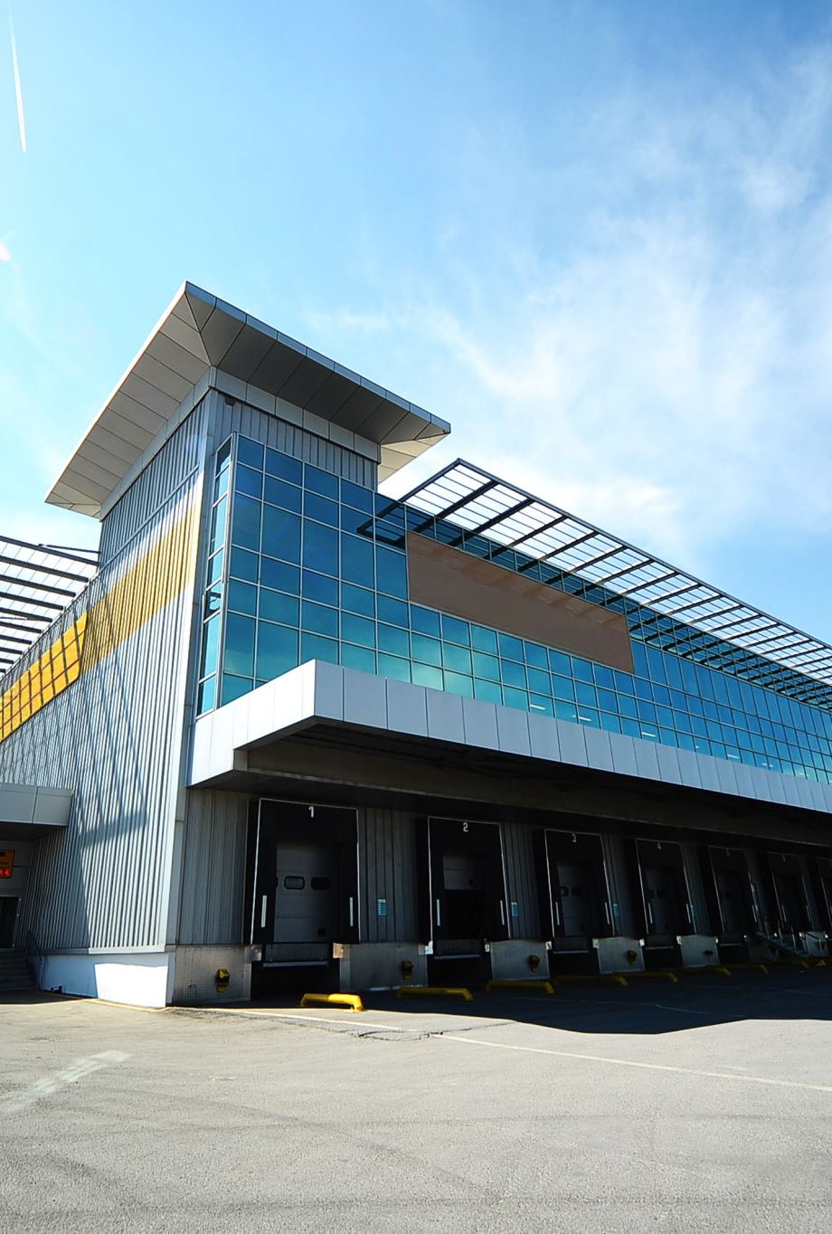
Tuition Assistant for Montgomery Employees
https://public.tableau.com/profile/david.williams8099#!/vizhome/TuitionAssistant/CountofDegreesbyDepartment?publish=yes
https://public.tableau.com/profile/david.williams8099#!/vizhome/TuitionAssistant/CountofMajorperDegree?publish=yes
https://public.tableau.com/profile/david.williams8099#!/vizhome/TuitionAssistant/AvgCostperDepartment?publish=yes

Slide 13

Earnings after Graduation
https://public.tableau.com/profile/david.williams8099#!/vizhome/montgomerycountycolleges/MontgomeryCollegeDashboard?publish=yes
https://public.tableau.com/profile/david.williams8099#!/vizhome/averageearningbytier/Averageearningbytier?publish=yes
https://public.tableau.com/profile/david.williams8099#!/vizhome/averageearningbyschool/Averageearningbyschool?publish=yes

Slide 14
Graduation Rate
This section analyze the factors that contributes to successful graduation

Slide 15
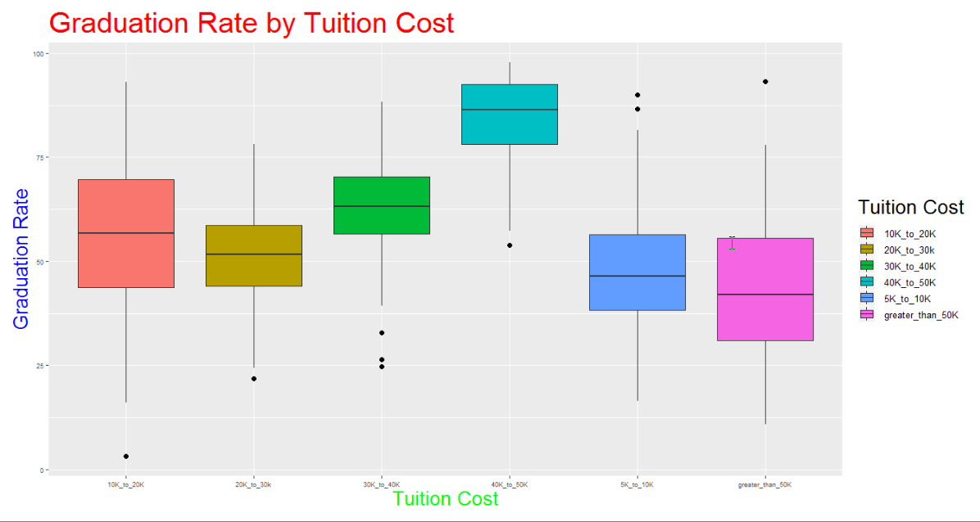

Slide 16
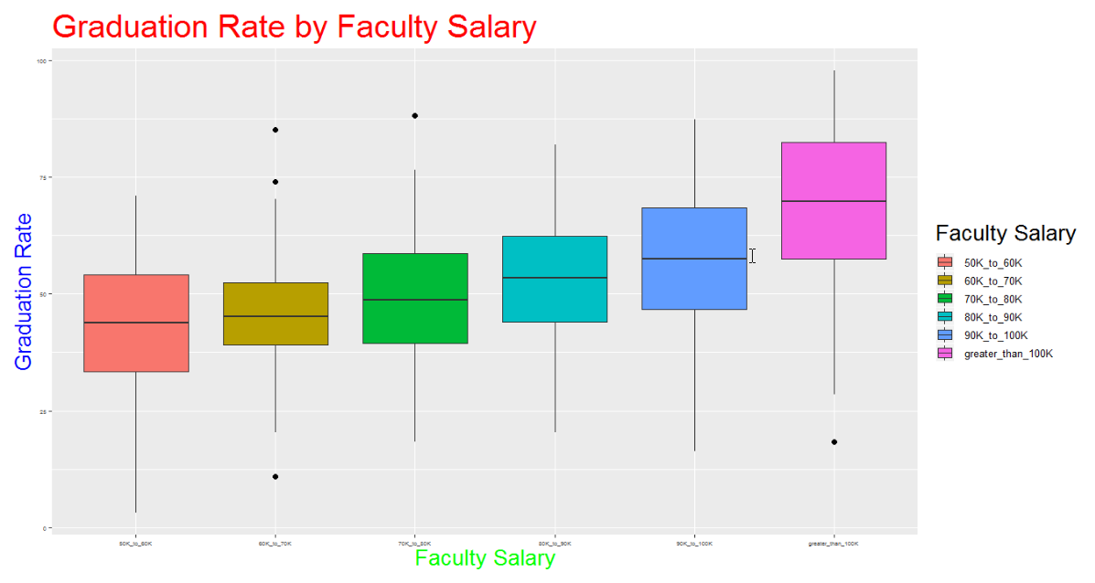

Slide 17
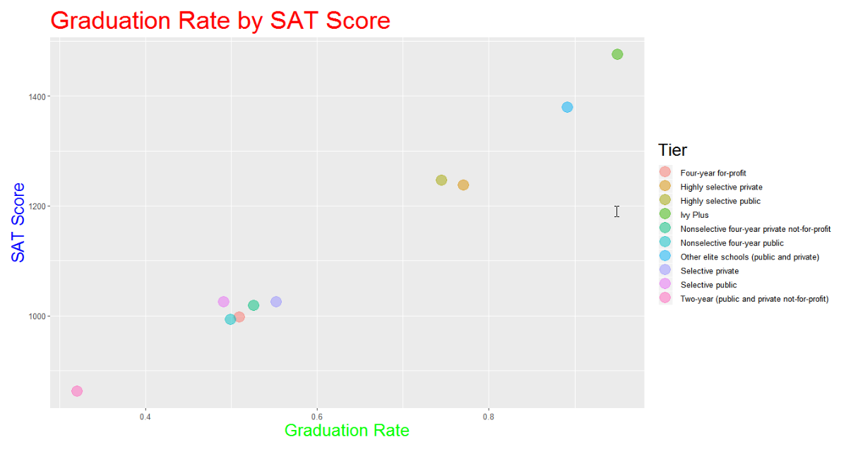

Slide 18
Graduation Rate by Tier
https://public.tableau.com/profile/david.williams8099#!/vizhome/GraduationRatebyTier/GraduationRatebyTier?publish=yes

Slide 19

References
Montgomery College Enrollment
https://data.montgomerycountymd.gov/Education/Montgomery-College- Enrollment-Data/wmr2-6hn6
Tuition Assistant
https://data.montgomerycountymd.gov/resource/p7z5-tjrz.csv
College Level Characteristics from the IPEDS Database and the College Scorecard
https://opportunityinsights.org/data/

Slide 20
Acknowledgements
Dennis Linders
Montgomery County Government
Victoria Lewis
Data Montgomery
Prof. Kathryn Linehan
Montgomery College – Data 205
Prof. Abdirisak Mohamed
Montgomery College – Data 201
Prof. Rachel Saidi
Montgomery College – Data 110
Prof. Melissa Lizmi
Montgomery College – Data 101

